Slide 1

‘PREDICTION OF RENT’
USING USA HOUSING LISTINGS DATASET
By:
Rishab Gunashekar(001040578)
Jatin Sharma(001524467)

Slide 2

SOURCE OF DATASET
https://www.kaggle.com/austinreese/usa-housing-listings

Slide 3
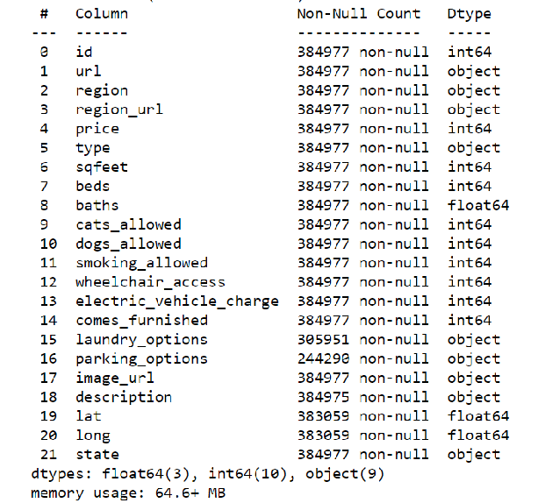
HOW WE CLEANED OUR DATASET?
Firstly, we removed features ‘id’, ‘url’, ’region_url’, ’image_url’ and ‘description’ which doesn’t play any role in the prediction of rent

Slide 4
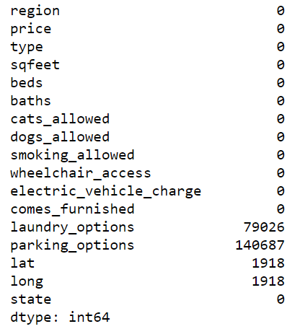
HOW WE CLEAN OUR DATASET?
Secondly, we handled missing values of dataset
Handled ‘laundry_options’ and ‘parking_options’ features missing values by replacing them with mode value of the column
Dropped rows of ‘lat’ and ‘long’ since the number of records were less than 1% of the dataset

Slide 5
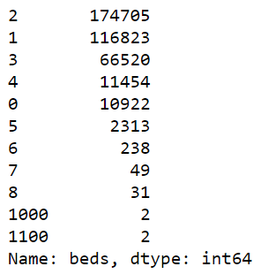
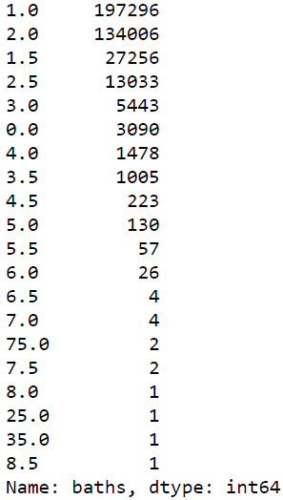
OUTLIER REMOVAL
To handle outliers of ‘baths’ and ‘beds’ columns, we assume that a house cannot have more than 5 beds and 5 baths and we removed the outliers accordingly

Slide 6
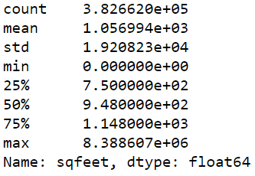
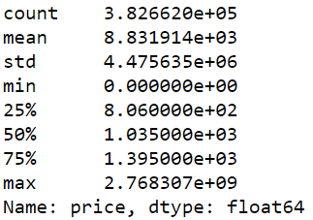
OUTLIER REMOVAL
For handling outliers of ‘price’ and ‘sqfeet’, we assumed that:
House rent has to be a minimum of 100 and maximum of 6000
House area to be a minimum of 150 and a maximum of 4000

Slide 7

DATA VISUALIZATION

Slide 8
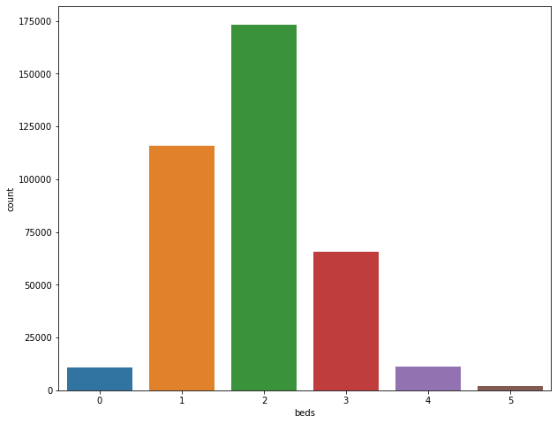
‘BEDS’ COUNT PLOT

Slide 9
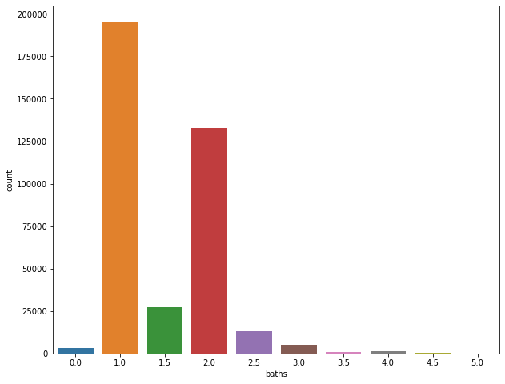
‘BATHS’ COUNT PLOT

Slide 10
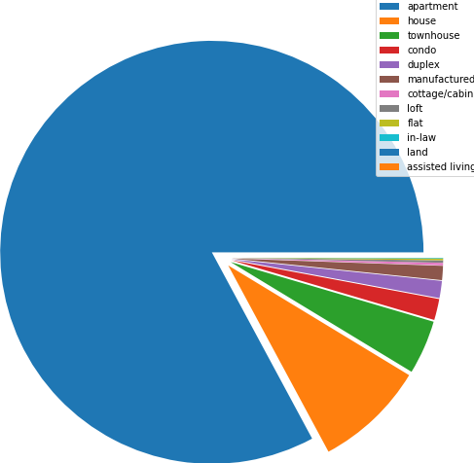
HOUSING TYPE DISTRIBUTION

Slide 11
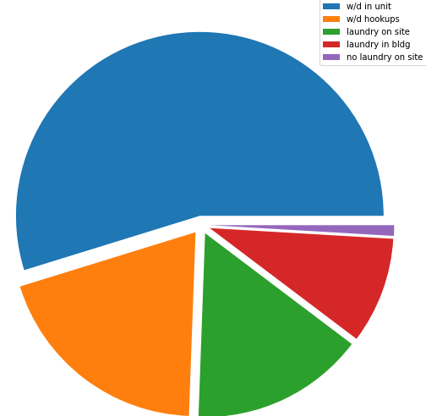
LAUNDRY OPTION DISTRIBUTION

Slide 12
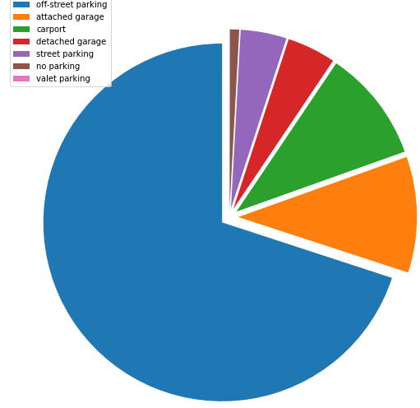
PARKING OPTION DISTRIBUTION

Slide 13
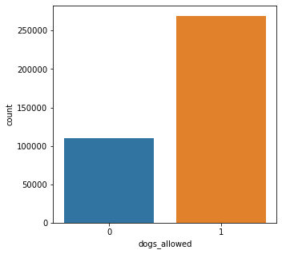
‘DOGS ALLOWED’ COUNT PLOT

Slide 14
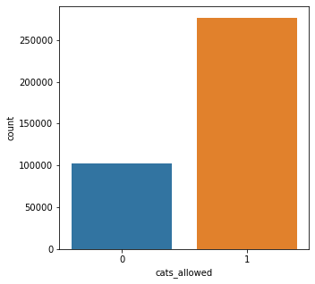
‘CATS ALLOWED’ COUNT PLOT

Slide 15
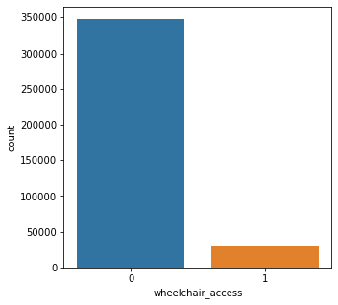
‘WHEELCHAIR ACCESS’ COUNT PLOT

Slide 16
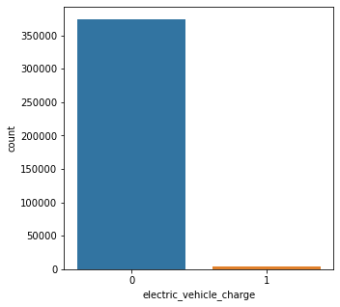
‘ELECTRIC VEHICLE CHARGER’ COUNT PLOT

Slide 17
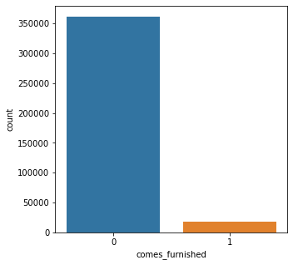
‘FURNISHED HOMES’ COUNT PLOT

Slide 18
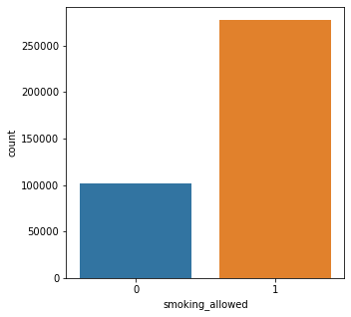
‘SMOKING ALLOWED’ COUNT PLOT

Slide 19
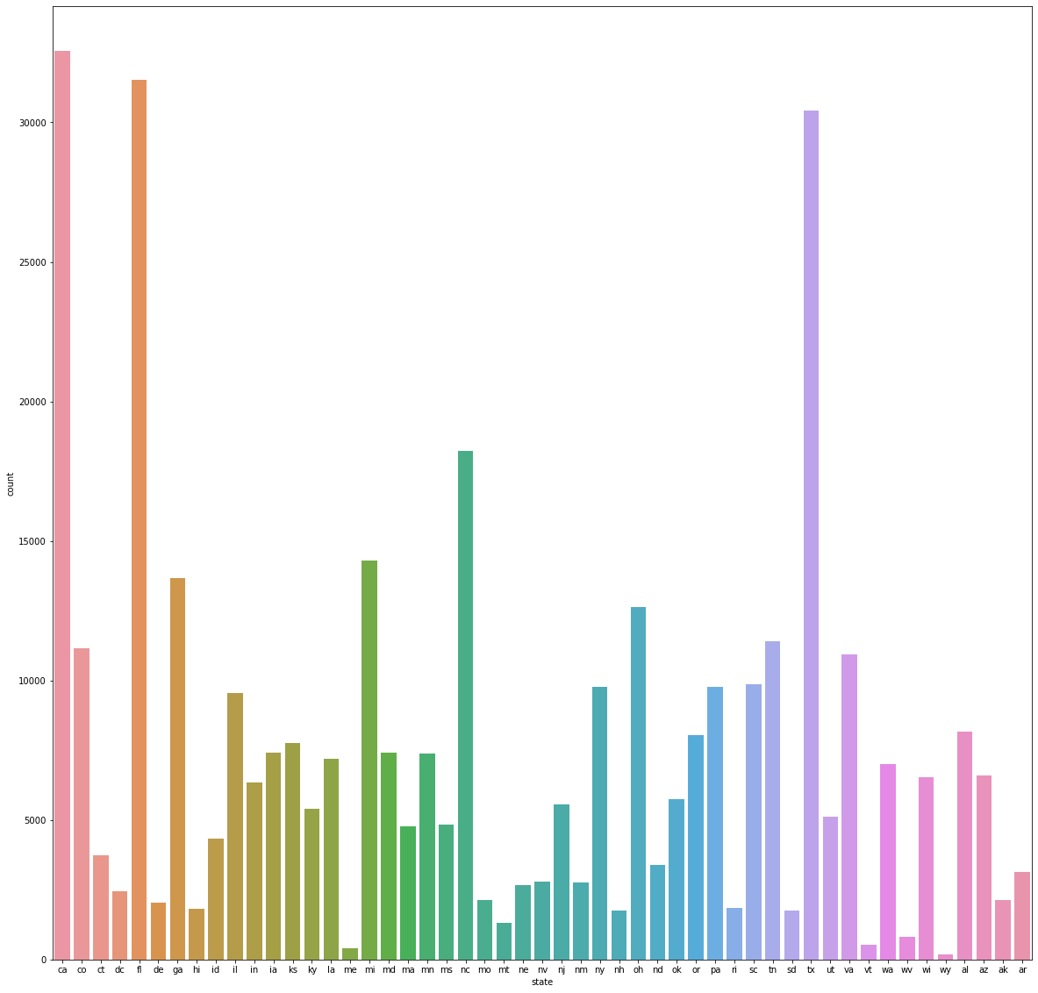
STATE WISE DISTRIBUTION

Slide 20
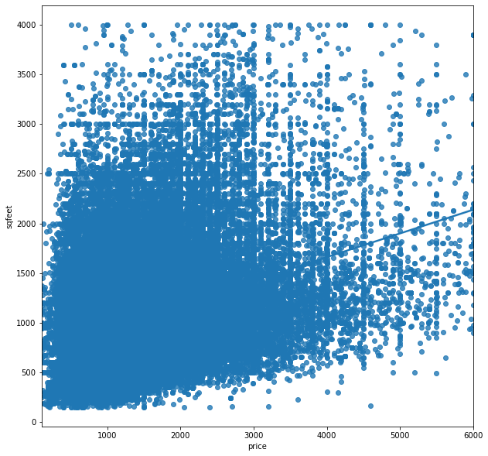
PRICE VS SQFEET PLOT

Slide 21
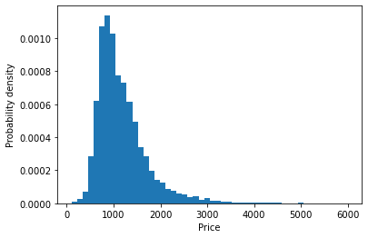
HISTOGRAM OF RENT PRICE

Slide 22
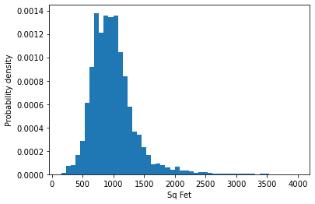
HISTOGRAM OF HOUSING PRICE

Slide 23
FEATURE ENGINEERING
Created new feature ‘rent_per_sqfeet’ by dividing ‘rent’ by ‘sqfeet’
Combined two columns ‘dogs_allowed’ and ‘cats_allowed’ into ‘pets_allowed’
Transformed the categorical variables like ‘region’, ‘laundry_options’, ’parking_options’ and ‘type’ into numeric by using LabelEncoder() method

Slide 24
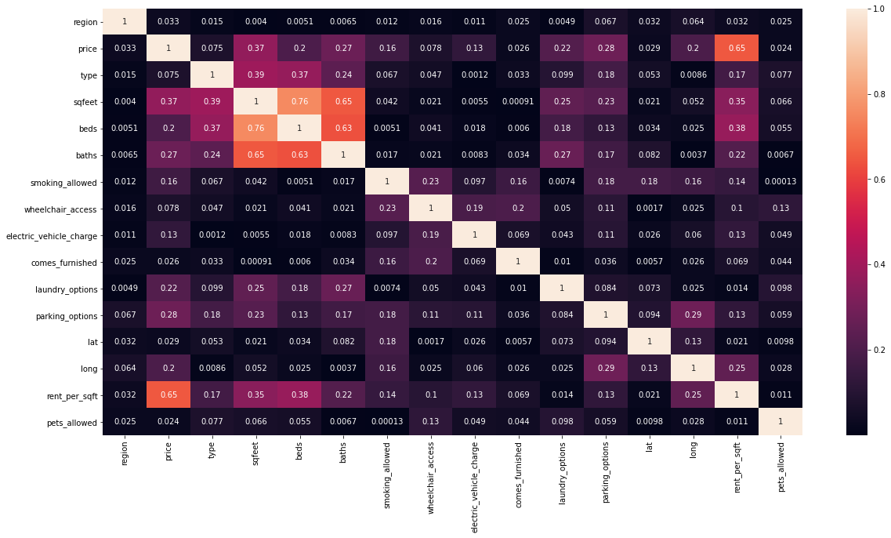
CORRELATION MATRIX

Slide 25
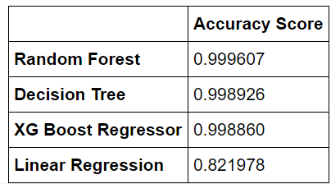
MODEL SELECTION
We used four Models in our dataset:
Random Forest
Decision Tree
XGBoost Regressor
Linear Regression

Slide 26

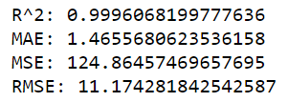
RESULT
From the previous scores, we are choosing the Random Forest Regressor for the estimation of rent prices.
The metric used to evaluate the model:
R-Squared
Mean Accuracy Error
Mean Square Error
Root Mean Square Error

